Slide 1
Announcements
Cool things in the world of Angular
November, 2013
http://goo.gl/UmWojc

Slide 2

2 AngularJS Releases!
AngularJS 1.2
AngularJS 1.2.1

Slide 3

AngularDart Beta
AngularDart 0.9 and 0.9.1

Slide 4
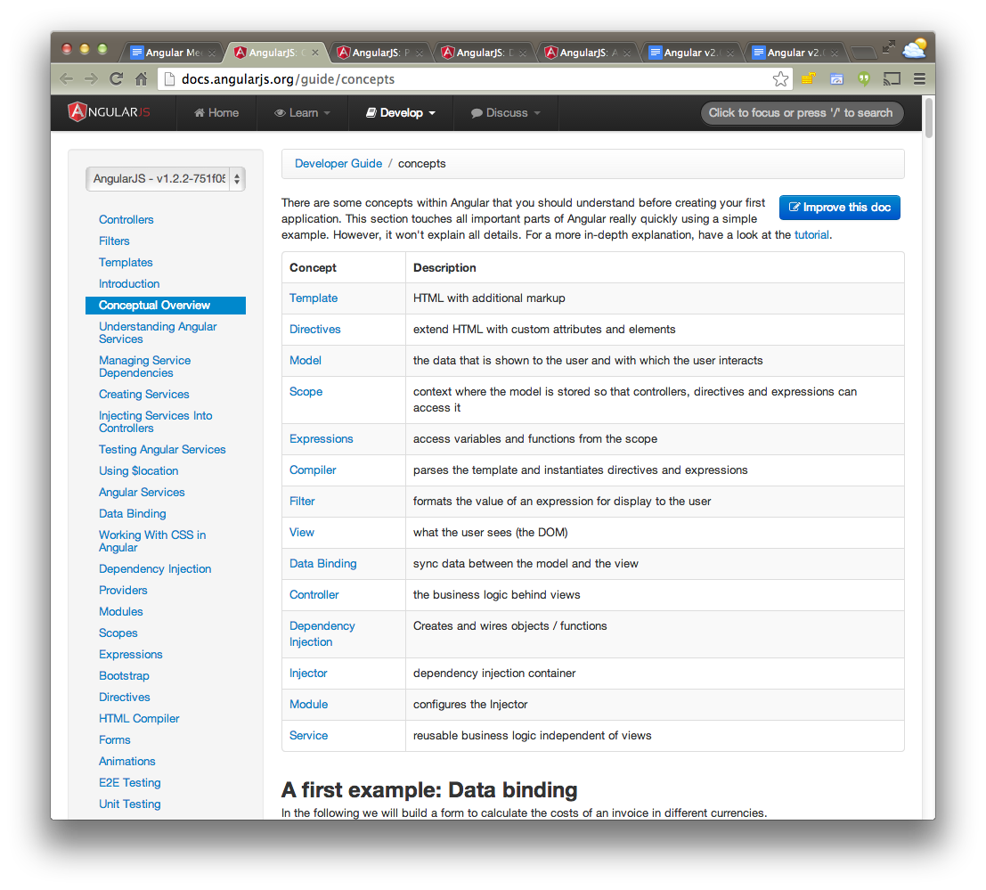
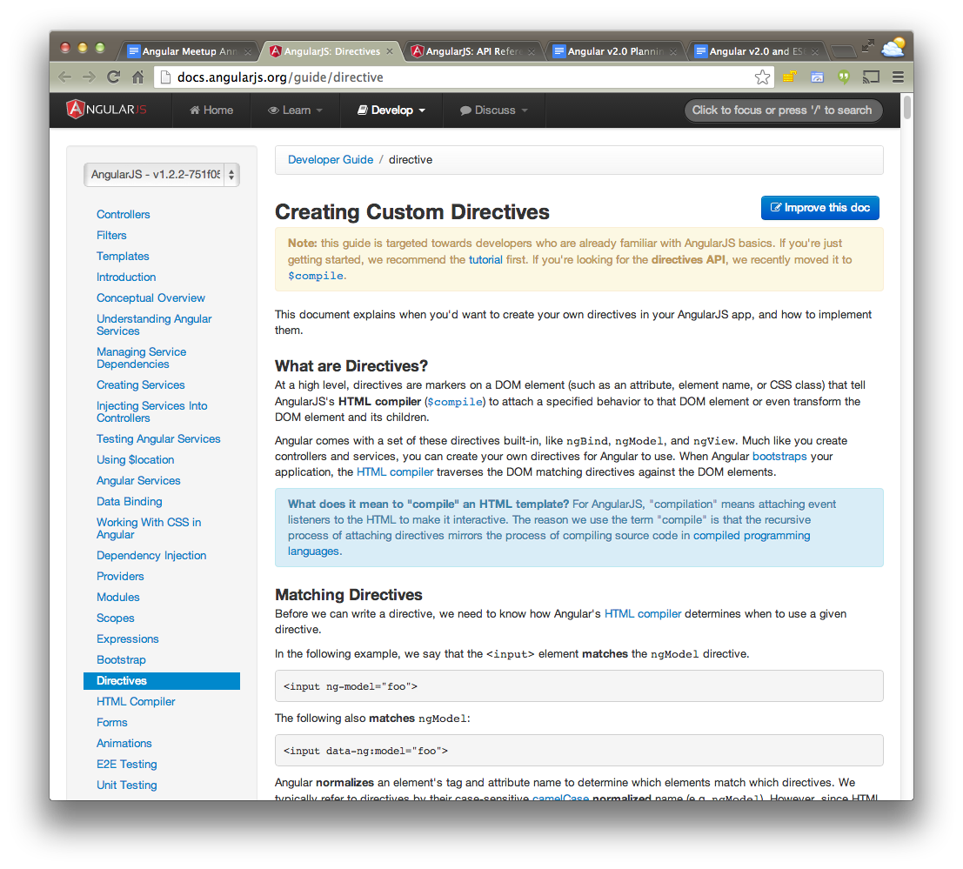
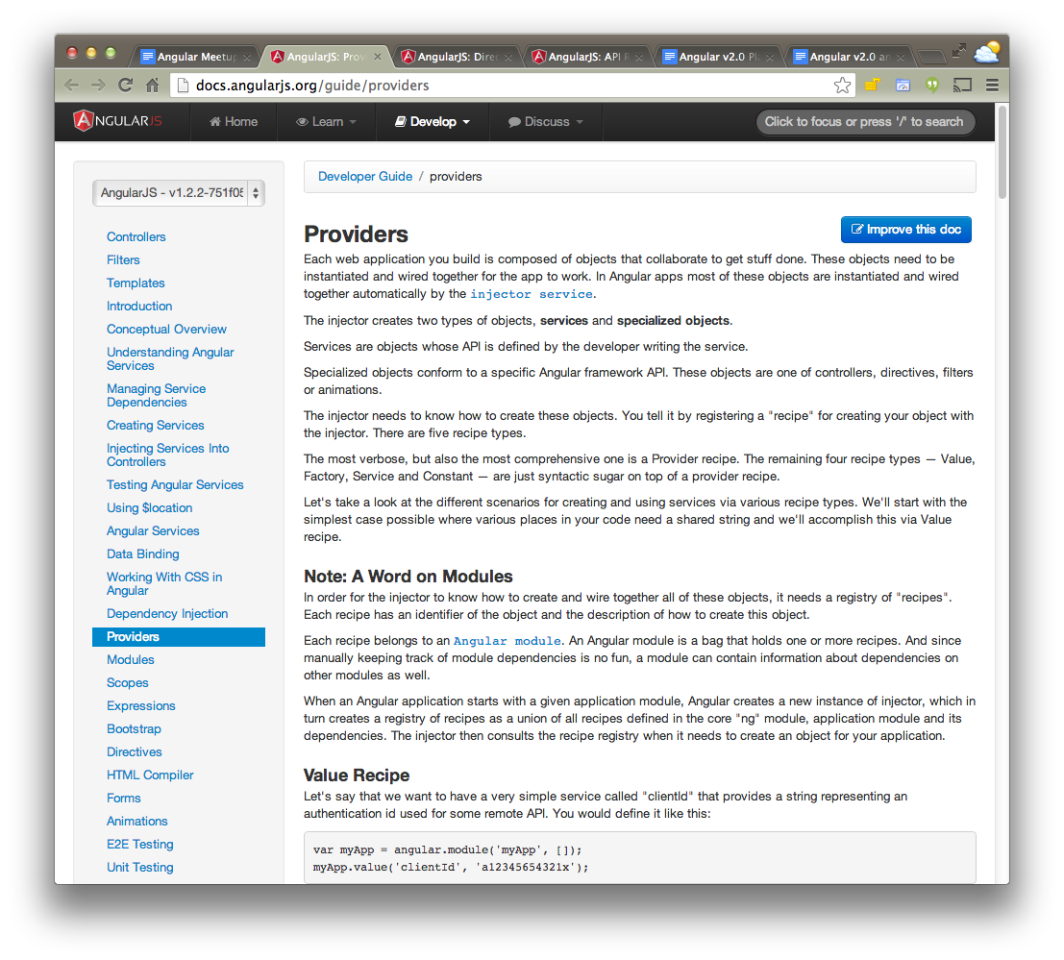
Docs Improvements
Concepts
Directives
Providers

Slide 5
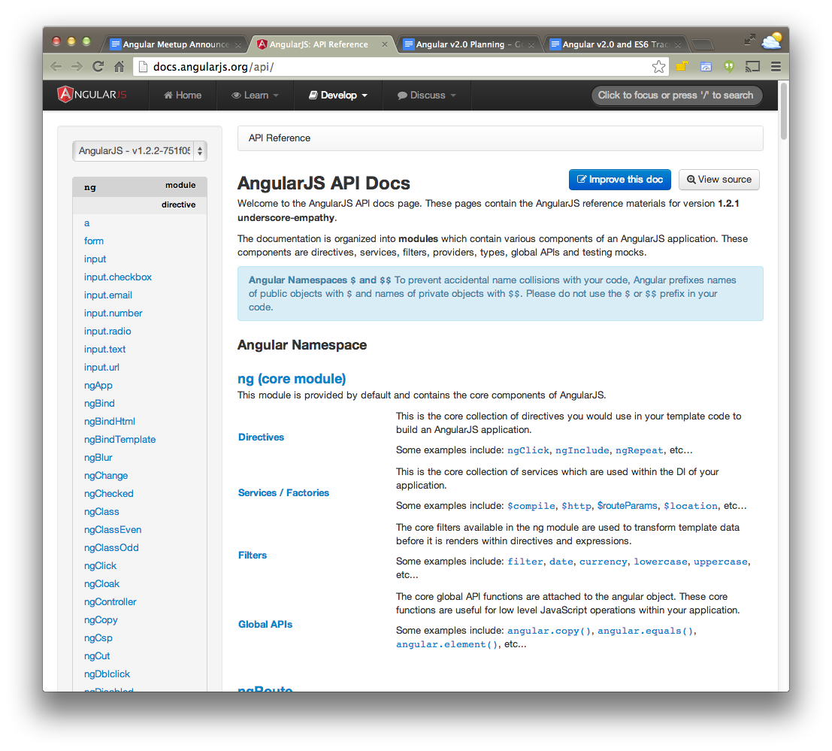
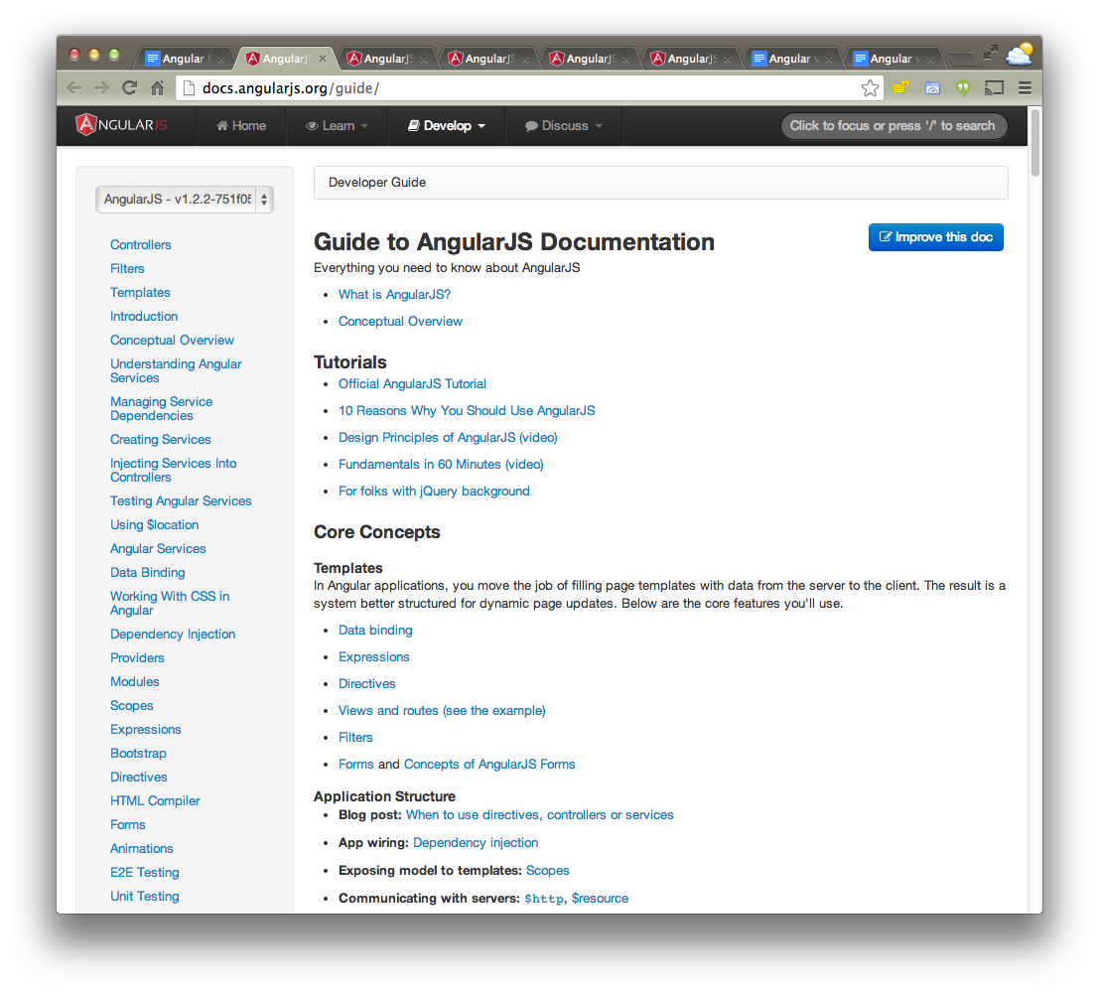
Docs Improvements
API
Guide

Slide 6


Thinkster.io + Firebase Tutorial
Tutorial

Slide 7

New book
Riding Rails with AngularJS

Slide 8
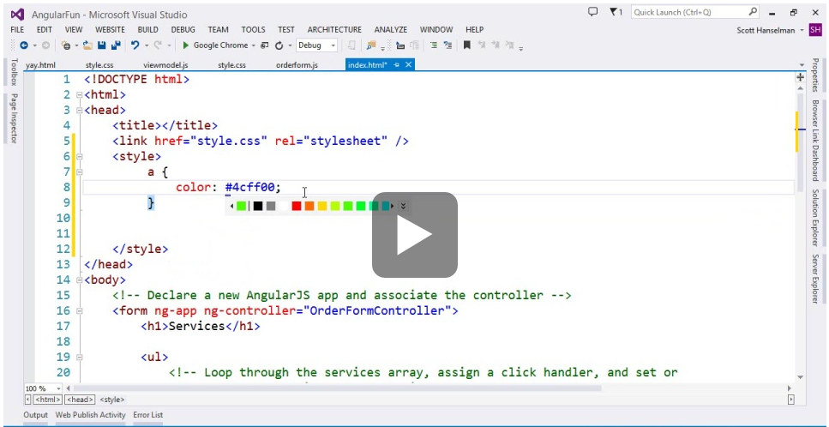
Editor support
Visual Studio
2013

Slide 9
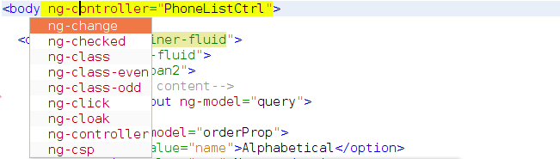
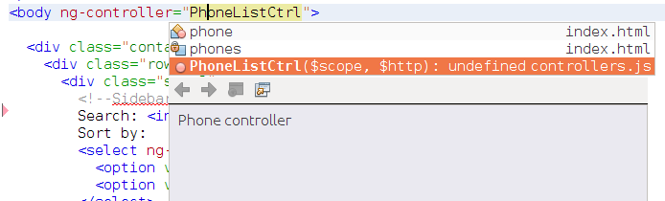
More editor support!
NetBeans 7.4

Slide 10

Mobile workshop
Develop PhoneGap
Apps with AngularJS
Nov 25 @ 6PM
San Francisco

Slide 11
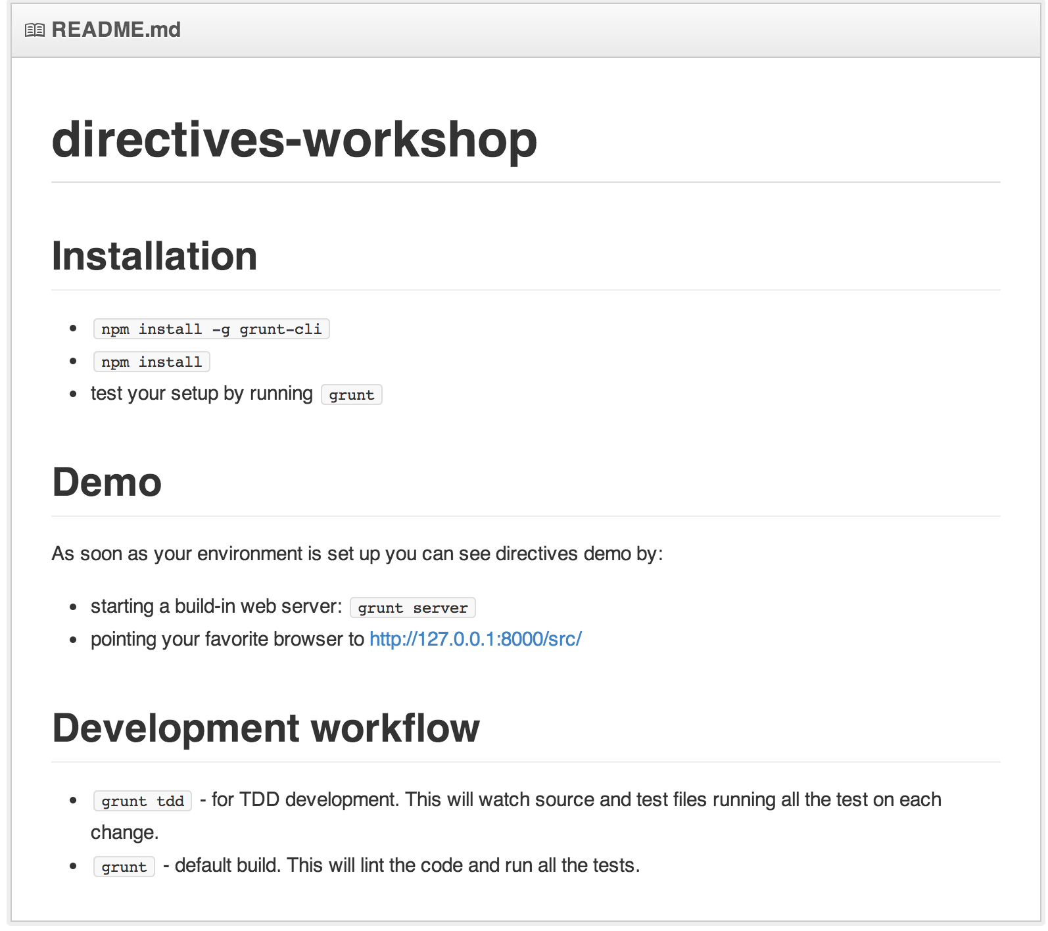
Angular directives workshop
Building
Angular Bootstrap components

Slide 12
Thanks!
http://goo.gl/UmWojc

